Slide 1
Sourcing: Navigation
May, 2013

Slide 2
Agenda
In this presentation and hands-on we will:
  Discuss logging in to Emptoris and Sourcing
  Show how to change user preferences
  Show the different homepage options

Slide 3
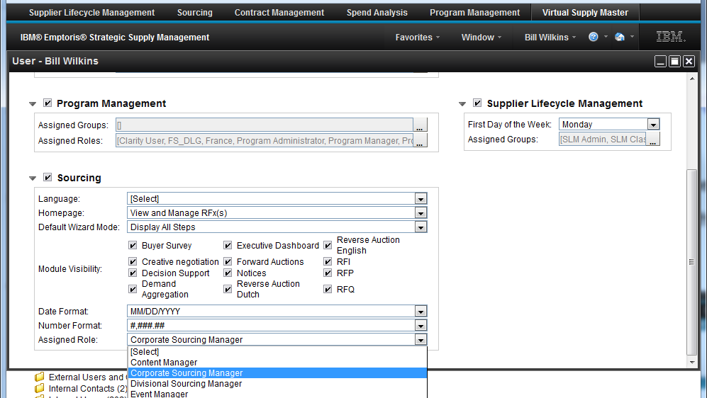
Logging in to Emptoris Sourcing
You actually log in to Emptoris SSM (Strategic Supply Management)
User Profile/Preferences determine what each user sees first after logging in
Following from VSM shows a Sourcing user that has been assigned the Corporate Sourcing Manager role (not shown: Sourcing is default application)
  Next slide shows what that user sees after logging in

Slide 4
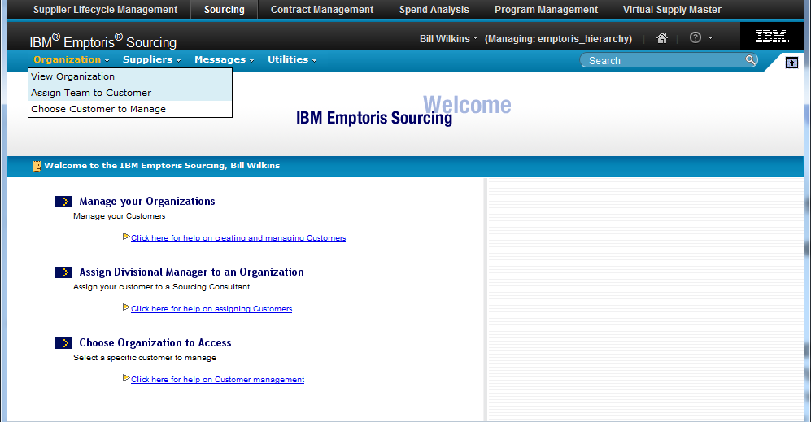
Logging in to Sourcing, cont.
Corporate Sourcing Manager can manage multiple Organizations, and he/she must choose which one to manage after login (or to switch to later in session)
  Organization > Choose Customer to Manage
Other users (such as Buyers) may be associated with only one Organization and would not need to choose one

Slide 5
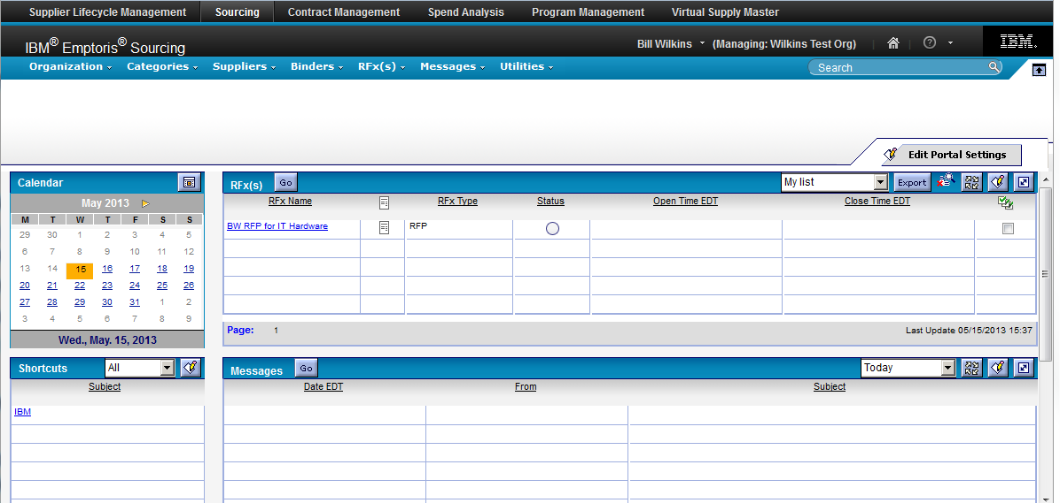
User Portal and other Homepage options
The options below are available for user's homepage (set in Profile).
  Portal Page (User Portal; shown below): Configurable set of portlets (calendar, list of RFx(s), etc.)
  Simple RFx Homepage: list of events with ability to take action on them; the “All” filter shows all events you are a buyer team member of
  View RFx(s) Calendar: list of events with focus on status and dates
  View and Manage … Binders or RFx(s) or Suppliers

Slide 6
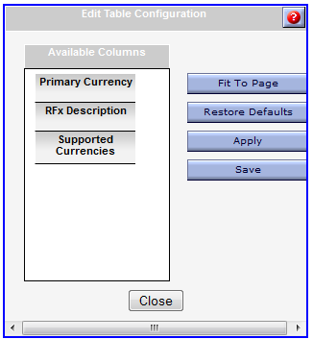
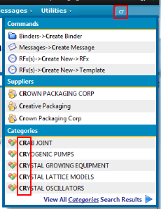
Page Customization; Searches
Many pages, such as “View and Manage RFx(s)”, can be configured in several ways. You can change the sequence or width of columns by dragging their headings or right borders. Also, by clicking the “customize list columns display” icon, you can remove or add columns: drag them to or from the Available Columns section of the “Edit Table Configuration” window ==>.
The Quick Search field in the upper right can be used not only to find (and quickly access) RFx(s), Suppliers, and Categories, but also Commands. (This is a “starts with” search.) E.g., entering “cr” would match several types of Create commands (as shown at right).
Hovering the mouse over many fields, icons, headings, and links will give you additional information.

Slide 7
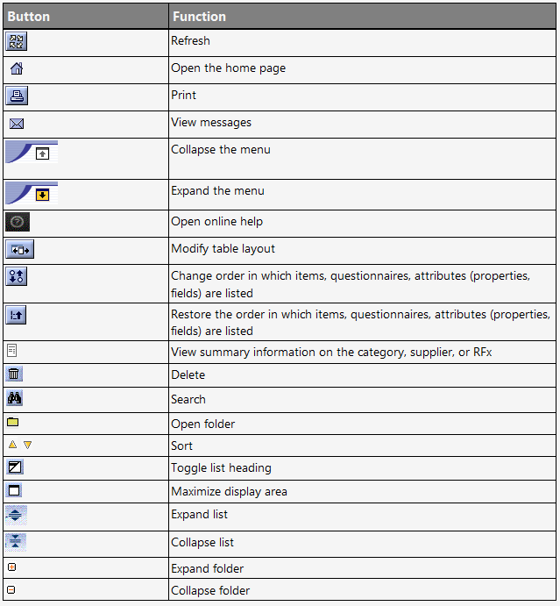
User Interface Icons

Slide 8
Demonstration and Ad Hoc Exercise: Logging in, preferences, navigation
Login using the assigned URL, BAM user ID, and password
In VSM, examine features available on the black toolbar: Favorites (edit an object such as a User, then “Add to Favorites”), Window, user name dropdown (direct link to User Profile and Preferences, and Inbox and Logout), Help, Home
In VSM, explore User Profile and Preferences (if possible; depends on user)
  VSM > Administration > Users > (optional search) > (select user)
  Applications tab > (view and optionally change Sourcing settings for user, especially Homepage and Assigned Role)
  Preferences tab > Landing Application > (change to Sourcing if not default)
Go to Sourcing and confirm that any changes made in VSM took effect
Survey features available on the blue toolbar: Organization, Categories, Suppliers, Binders, [skip RFx(s) for now], Messages, Utilities, Search
  (more coverage of these later)

Slide 9
Demonstration and Ad Hoc Exercise: Exploring Homepage alternatives
Click on the Home icon to go to Sourcing Portal (if necessary, either click on “Portal” in the dropdown menu at the user name, or change the Homepage in the user's Profile to be the Portal)
  Use the “Edit Portal Settings” button to (e.g.) rearrange the tiles and add a new tile to access Contracts (on the Portal Setup and Configuration window)
  Back on the Portal, look at the buttons available on the tiles: Export, Edit (change the columns displayed in the RFx(s) tile), filter options (based on date selected in calendar, or My List),
  Make an existing Shortcut visible (e.g., View Categories) by dragging it across to the Visible column. Add a new Shortcut (e.g., add “http://www.ibm.com” as URL; you must use the whole string and not “ibm.com”, for example) and make it visible. Test the shortcuts.

Slide 10
Demonstration and Ad Hoc Exercise: Exploring Homepage alternatives, cont.
From the RFx(s) dropdown, try each of these (as Homepage alternatives):
  Simple RFx Homepage
    Provides a list of RFx(s), with basic information for each
    Use the dropdown under Events to filter by RFx status or using My List
    Try the Actions menu to the left of an event, the link to Create new events, and the link to go to Reports
    Try the dropdown for each column to sort or omit columns
  Manage RFx(s)
    Gives a more detailed list of RFx(s), and can also manage templates
    Sort on a column by clicking on its heading link
    Try the context menu to the left of an event
    Select an RFx and add it to My List
    Perform a search (use “*” as wildcard)
    Look at the Gantt (graphic view of event status) and Templates tabs
  View RFx(s) Calendar
    Lists RFx(s) by scheduled open date (month, week, or day view)
    Explore the different views and the menu to filter by event type

Slide 11

Questions?

